Slide 1

An Analysis of the Indian Agricultural Industry
Prepared and Presented by: Temiloluwa Priscilla Jokotola

Slide 2
Table of contents
01
02
03
04
05
Introduction
Exploratory Data Analysis
Crop-specific Analysis
06
Regional Disparities
Power BI Visuals
Recommendations

Slide 3
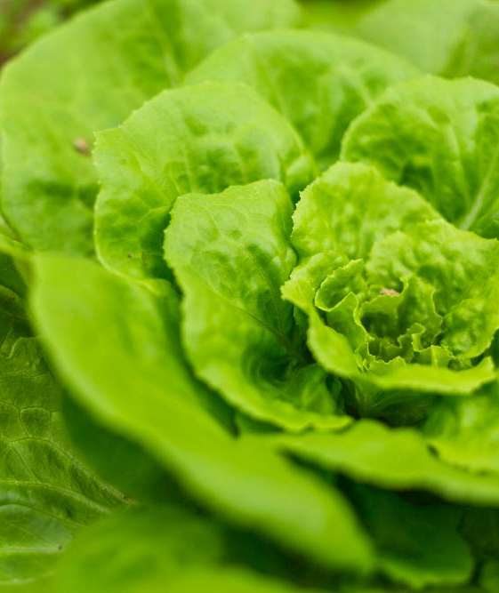
Introduction
A comprehensive analysis of Indian agriculture, focusing on district-wise and year-wise data. The dataset used for this analysis provides detailed information on various crops, their areas, production, and yields across different districts and years. The dataset was analysed via MS EXcel and Power Query, and Power BI was used to create interactive visualizations that uncover trends, patterns, and disparities in agricultural practices. Recommendations was thereafter provided to enable
stakeholders to make informed decisions for sustainable farming and resource allocation.

Slide 4
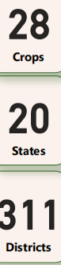
Exploratory Data Analysis
Dataset spans across 51 years (1966-2017)
Analysis covers 20 states and 311 districts
28 crops were considered, including their production, yield, and areas

Slide 5
Major Crop-Specific Analysis
There has been a sporadic increase in the farmland areas of rice and wheat in the past 51 years, while potatoes and onions has remained static over the years
2016 recorded the largest production of rice, wheat, and sugarcane
Safflower recorded an all-time low for production

Slide 6
Regional Disparities
Rice
Barley
Luchiana district and Uttar Pradesh state has the largest yield of rice
** West Bengal> Uttar Pradesh
Sangrur district and Uttar Pradesh state has the largest yield of barley
Wheat
Sugarcane
Luchiana district and Uttar Pradesh state has the largest yield of wheat
South Arcot district and Uttar Pradesh states has the largest yield of sugarcane

Slide 7

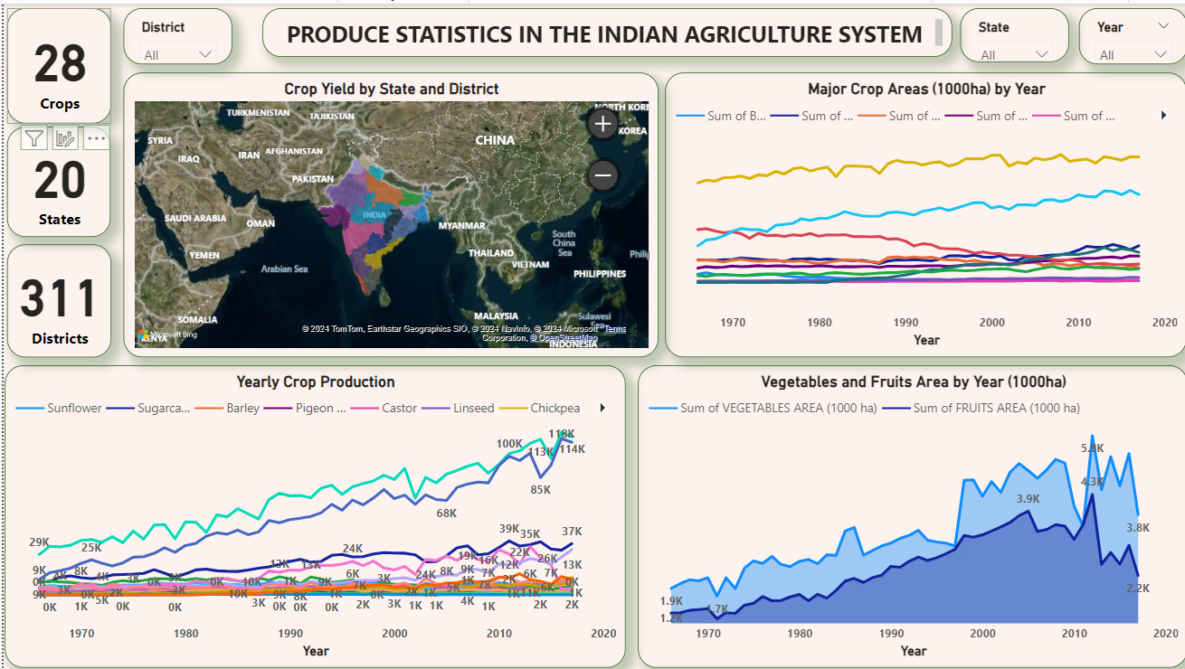
Power BI Visualization

Slide 8
Recommendations
Analysis shows that the state of Uttar Pradesh has the largest land areas for major crops like Rice, Barley, Wheat, and Sugarcane. Due to this they have the highest yield of major crops EXCEPT rice. West Bengal has a slightly higher rice yield than Uttar Pradesh. Given the production capacity of West Bengal and other states, the following recommendations are provided:
- Diverting agricultural investment to West Bengal and other minority states
- Shifiting key crops like rice, wheat, and barley to neighbouring states and districts
- Implementing agricultural technology to boost production in districts and states with low yield
- Allocation of more farming lands

